Slide 2
Welcome to my Halloween lesson.
I hope you are ready for a scary moment.

Slide 3
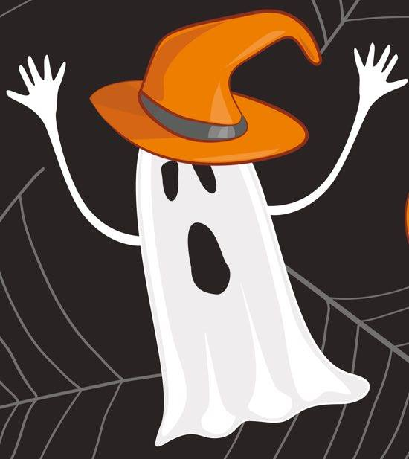
PUMPKIN GHOST
Listen and repeat
Listen and repeat

Slide 4
I am a witch
Listen and repeat

Slide 5
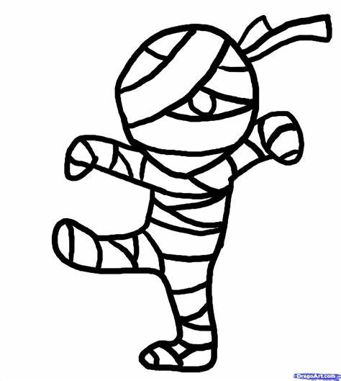
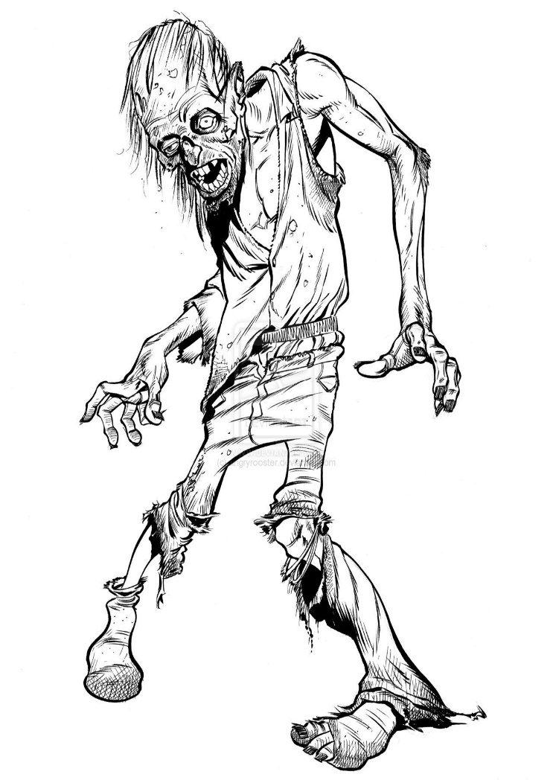
Skeleton Mummy Zombie
Listen and repeat
Listen and repeat
Listen and repeat

Slide 6
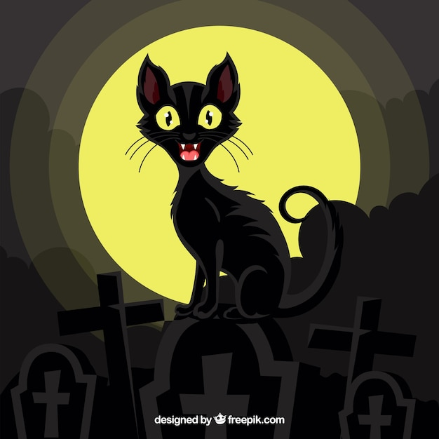
Vampire Bat Black cat
Listen and repeat
Listen and repeat
Listen and repeat

Slide 7
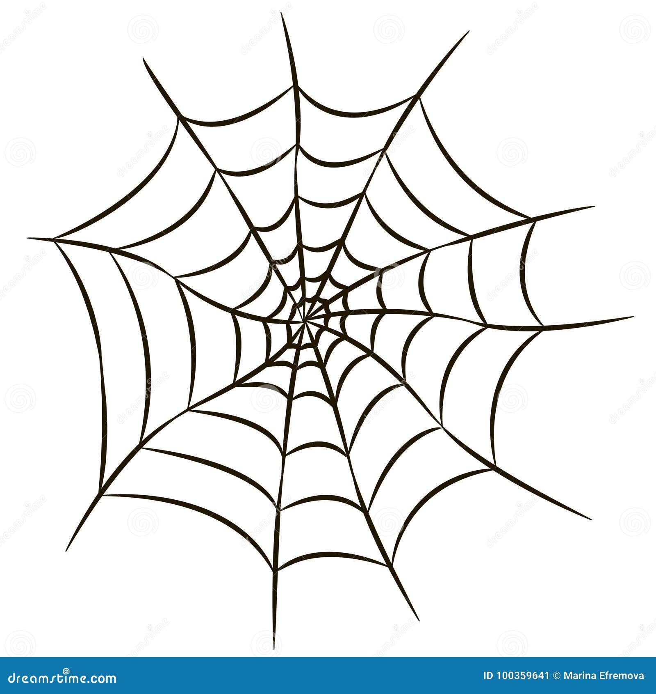
Spider Spiderweb
Listen and repeat
Listen and repeat

Slide 8
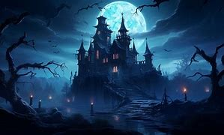
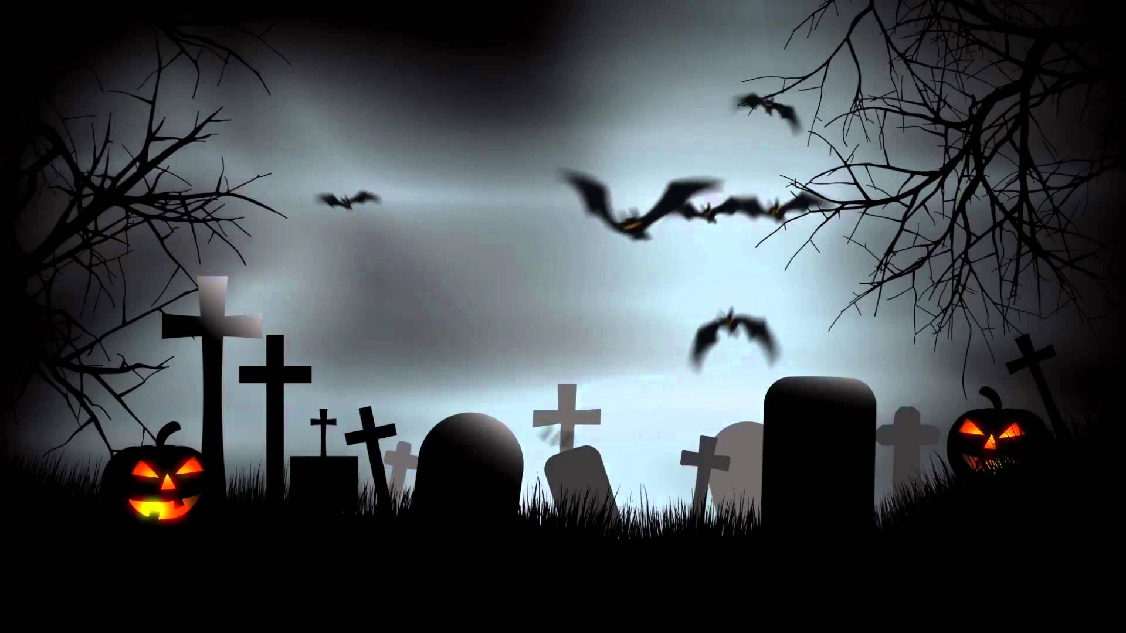
Haunted Castle Cemetery house
Listen and repeat
Listen and repeat
Listen and repeat

Slide 9
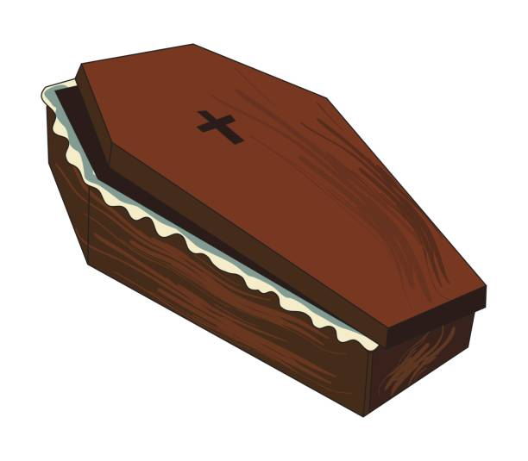
Magic Magic Coffin Flying cauldron Potion Broom
Listen and repeat
Listen
and repeat
Listen
and repeat
Listen and
repeat

Slide 10
Happy Halloween

