Slide 1
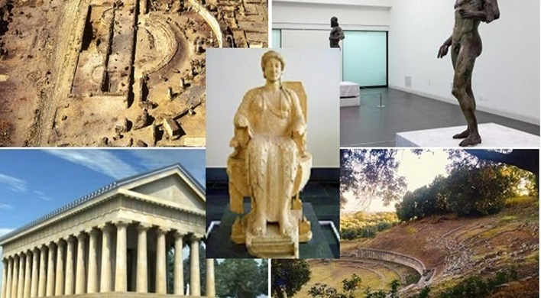
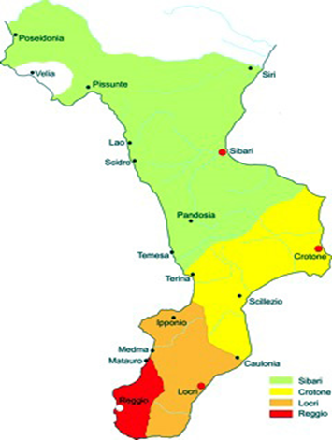
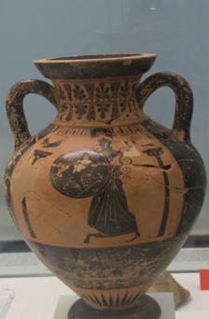
CALABRIA : HEART OF MAGNA GRAECIA
The fertile lands, the mild climate, the geographical position and the good and hospitable people are the reasons why Calabria was colonized

Slide 2
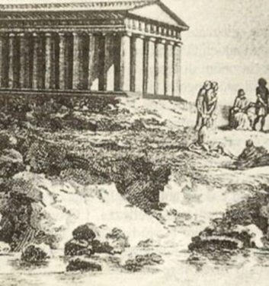
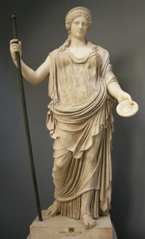
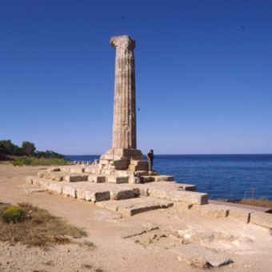
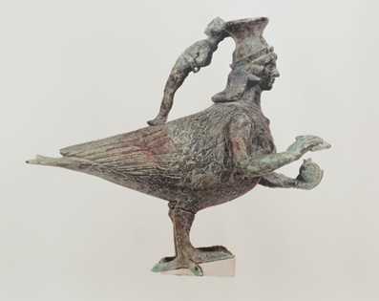
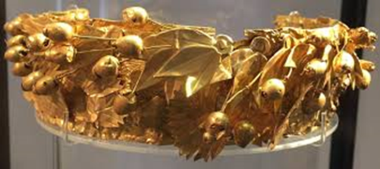
CROTONE :ICON OF MAGNA GRAECIA
Sanctuary dedicated to Hera Lacinia, patron goddess of Crotone. Today only one column remains of the sacred building. The National Archaeological Museum houses the treasures of Hera Lacinia.

Slide 3
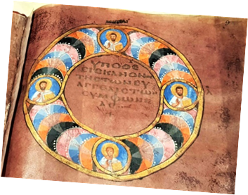
ROSSANO: CITY OF CODEX
The Purple Codex is one of the oldest Greek manuscripts and contains the texts of the Gospel of Mark and Matthew.Recognized by UNESCO as a World Heritage Site.

Slide 4
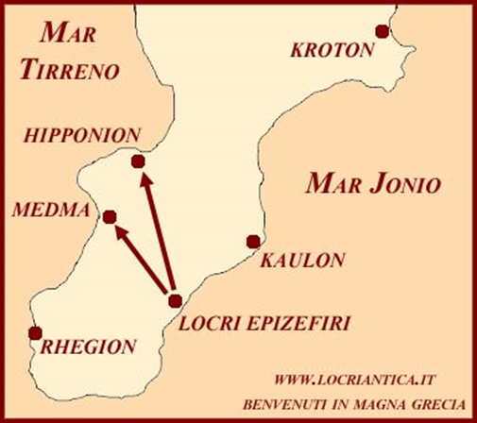
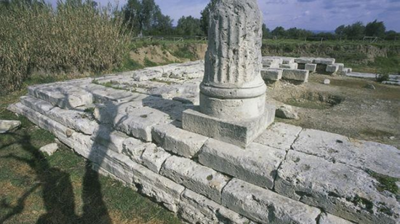
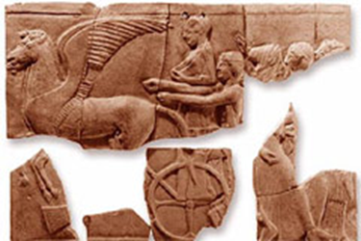
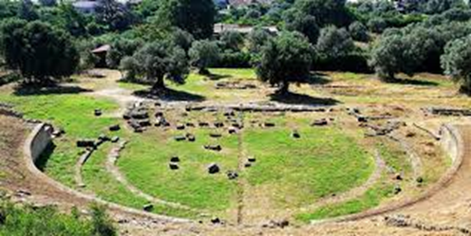
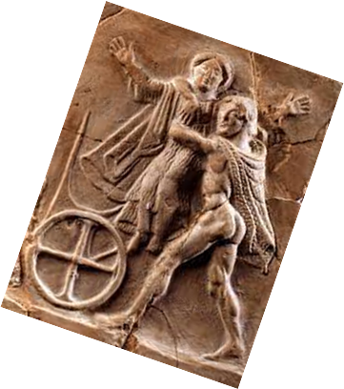
LOCRI: BEAUTIFUL GREEK COLONY
Pinkes: terracotta tablets bearing bas-relief representations of the scoial and religious life of ancient Locri.
Archaeological site

Slide 5
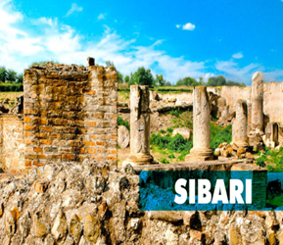
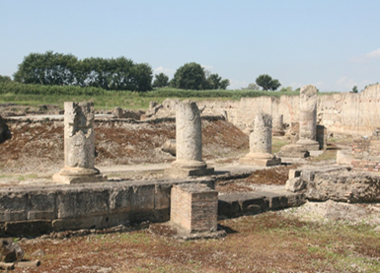
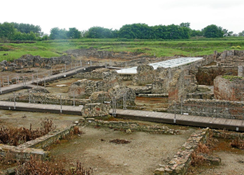
MAGNA GRAECIA: SYBARIS
Historically it was one of the main cities of Magna Graecia, it is located between the rivers Crati and Coscile (the latter in Greek was called Sibarys, hence the name of the locality).

Slide 6
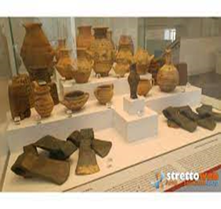
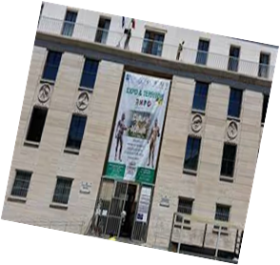
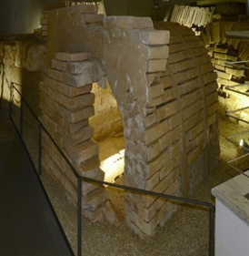
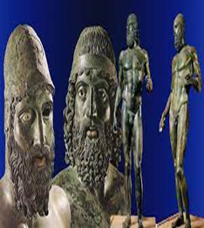
MAGNA GRECIA: REGGIO CALABRIA
The city took the name of Rhegion. The term refers to the Greek verb "ρήγνυμι" which means to break, to break in memory of the geological split of Sicily from Calabria. During the construction of the museum, a Hellenistic necropolis came to light.

Slide 7
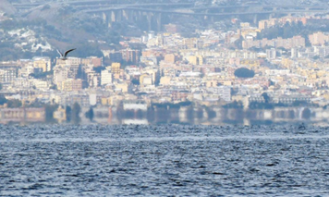
CALABRIA: HISTORY, MYTHS AND LEGENDS
AT THE MORGANA GIRL It is said that the fairy Morgana, to induce King Roger I to conquer Sicily, with a wave of a magic wand, made her appear so close to him to touch her with his hand. But the king refused to take the island by deception. It then took him 30 years to conquer it. Even today it happens that on calm and clear days of summer, from the Calabrian coast you can distinguish well the houses, cars, people walking in the streets of Messina.

Slide 8
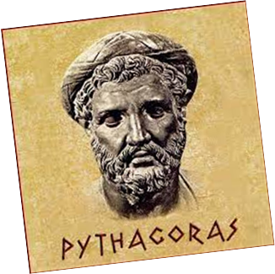
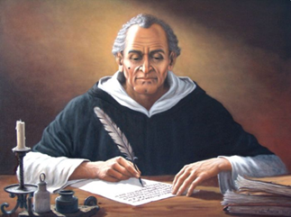
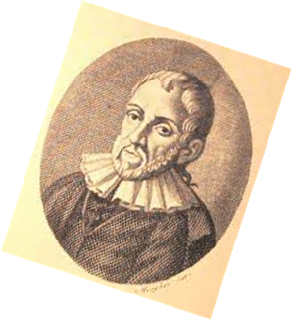
CELEBRITIES
Calabria has given birth to many famous people who have distinguished themselves in the world for their culture, their work, their tenacity. We remember Francesco di Paola, today patron saint of Calabria. Bernardino Telesio famous philosopher of Cosenza. Tommaso Campanella philosopher and poet of Stilo. Pythagoras philosopher and mathematician of Crotone.

Slide 9
HISTORY ACTIVITIES: CALABRIA: HEART OF MAGNA GRECIA Fifth classes of the IC CROSIA Street of ART Erasmus+ KA 122 Seasonal@Glocal Mobility for individual learning FUNDED BY THE EUROPEAN COMMUNITYPROJECT CODE: 2021-1-IT02-KA122-SCH-000013562

