Slide 1
Food around my country Iraq!

Slide 2
Breakfast in JORDAN
Friday, a holiday in Jordan for all the families most of the Jordanian families have a great breakfast. The most famous food at the break fast table is Homos , Al Foal and Flafel with the traditional beverage ‘tea”.

Slide 3
Usually we love to put Tomatoes and cucumbers at the table next to the original breakfast things such as: cheese, egg and olive.

Slide 4
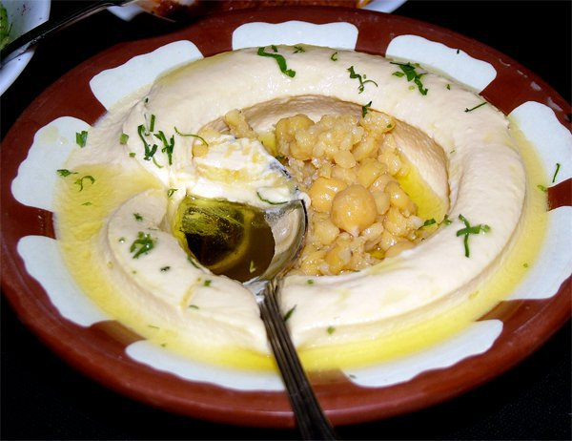
Homos:
We may put fried grounded pieces of meat on it.
We fry the meat and put it on the homos, it should be hot.
You can put it without meat too!

Slide 5
Foul
Haricots Is the Foal we brassage It and put some tomates , olive oil and some persil on it.
You Can buy It from special places if you dont want to make it at the house.

Slide 6
This is the Falafel, it has a great taste.

Slide 7
Tea is something very important in Jordan, we drink it at night, evening, and mostly on break fast Most people love it anytime during the day.

Slide 8
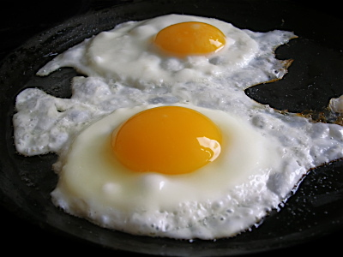
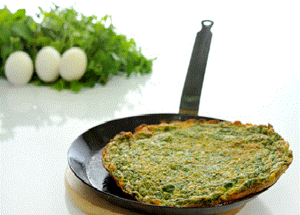
Another important thing we love at break fast is egg.
We fry it or boil it, we can make it omelet, or we can add some parcel and fry it

Slide 9
White bread
White cheese
Labaneh
Egg with hotdogs

Slide 10
Hope you like it
Achiropita Acri IIIC

