Slide 1
THE BIG READ

Slide 2
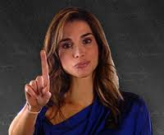
The Big Read is a campaign about education and it’s promoted by the UNESCO with the partecipation of Jordan’s Queen, Rania Al Abdullah.
The Jordan’s Queen “ Rania Al Abdullah

Slide 3
The objectives of the Big Read are the right to education for all.
In fact, in the world, 776 million adults lack literacy skills, 75 million children are out of school and so they can’t read and write and millions more leave school early without acquiring basic literacy and numeracy skills.

Slide 4
Literacy is a basic right and it’ s a key to reduce poverty, increase economic opportunities, improve health, prevent HIV and AIDS and encourage political participation.

Slide 5
The director of Big Read is Bjorn Larsson Queen Rania wanted to take part in the Big Read and she wanted to build schools for children.

Slide 6
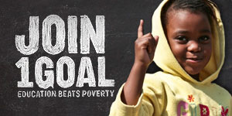
Besides, Queen Rania with FIFA, Gary Lineker and footballers launched 1 goal: EDUCATION FOR ALL.

Slide 7
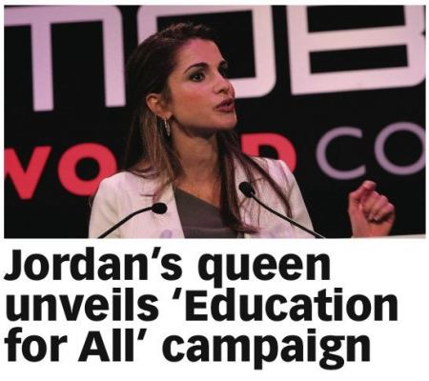
“I’m proud to support 1GOAL; it isn’t asking for money, it’s asking for your name, your commitment to fair play for future generations,” said Her Majesty Queen Rania of Jordan.

Slide 8
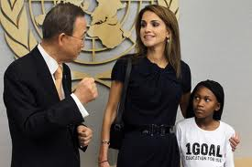
Players from all over the world are joining the effort including Rio Ferdinand, Thierry Henry, Robinho, Essien, Mokoena, Kanu, Anelka, Silvestre, James, Kolo Toure, Javier Zanetti, Ivan Cordoba, Michael Owen and Mia Hamm, Desailly, Weah and Milla. Today’s event was hosted by England football legend Gary Lineker.
In addition to FIFA’s support, Geldof, Bono, Spacey, Rowland and organizations Global Campaign for Education, Comic Relief and the One Campaign have promised their commitment.

Slide 9
From 20th to 26th April 2009 the Big Read promoted a Global Action Week and it focuses on youth and adult literacy and life-long learning to raise awareness about the global literacy challenge.
The slogan of Global Action Week is “Open Books, Open Doors”.

Slide 10
The highlight of the campaign is the “Big Book”, a collection of short stories about how education changes lives. “Big Read” events will be organized, during which individuals will read from this book and sign a statement at the back of it calling for more commitment and investments to ensure that everyone is able to read and write.

Slide 11
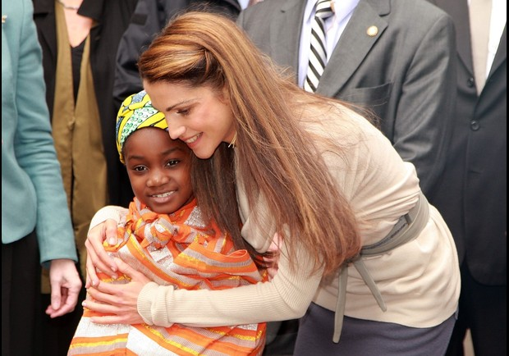
Nelson Mandela said: <<Education is the most powerful weapon to change the world.>>

Slide 12
CREATED BY : Achiropita Acri III ° C
☺BYE☺

