Slide 1
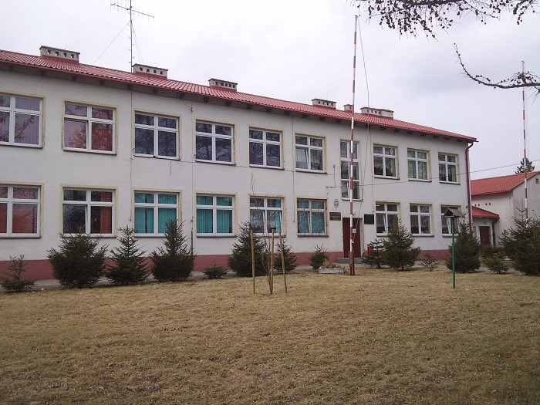
Middle School named 27 Volhynian Infantry Division Army

Slide 2
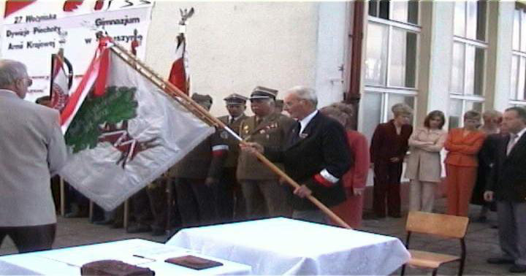
History
Our school was founded in 1999, based on previous school. First director of the gymnasium was mgr Danuta Kawecka. In 2002. We adopted a 27 Volhynian Infantry Division Army - this is our patron. It is a modern school, setting to achieve success in life.

Slide 3
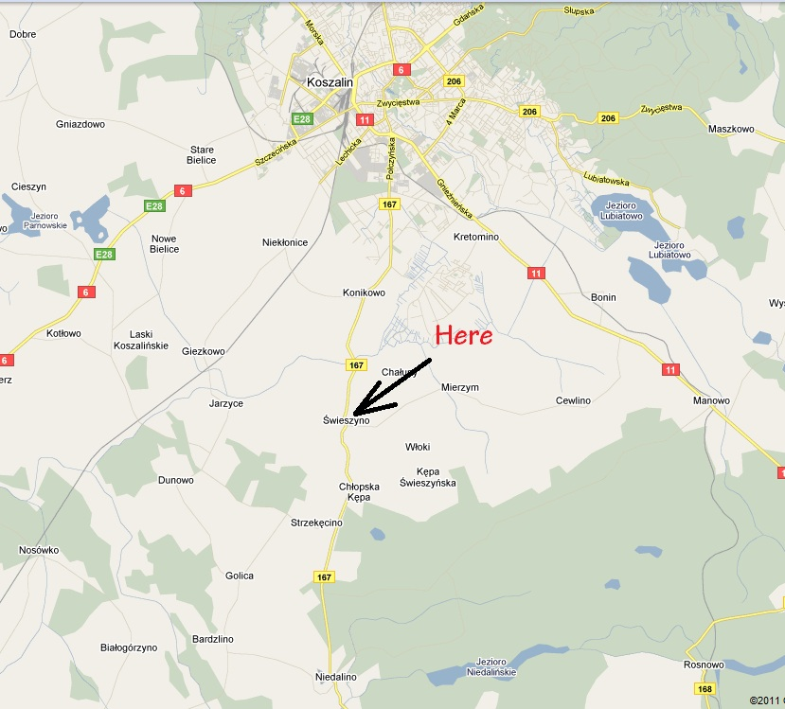
Where is it located

Slide 4
About what is in school
-4 multimedia labs with 2 interactive whiteboards and an LCD TV -Portal log School -15 modern computers -Many circles of interest -Monitoring -Kitchen serves lunch -Remedial teaching -Various tournaments Director's Cup -Interesting events

Slide 5
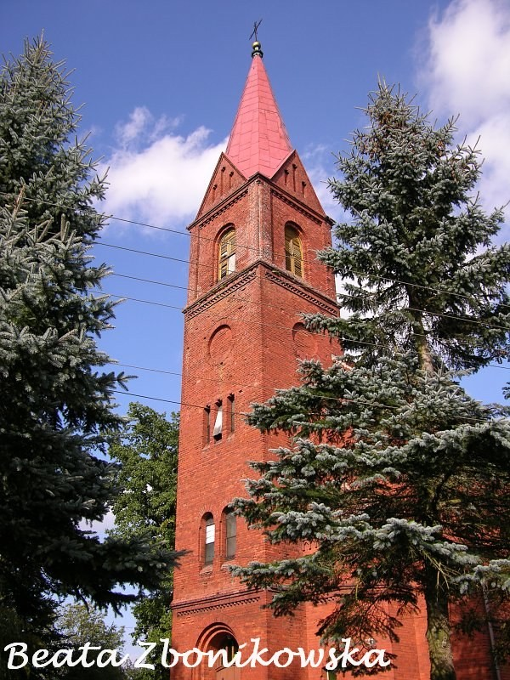
What is in our community
Parish of the Nativity call the Blessed Virgin Mary
Parish of Nativity of the Blessed Virgin Mary in Świeszynie was established in 1973. It belongs to the deanery Bobolice Diocese of Koszalin-Kolobrzeg. The parish church was built in the nineteenth century, devoted to 1945. It is located at number 23

Slide 6
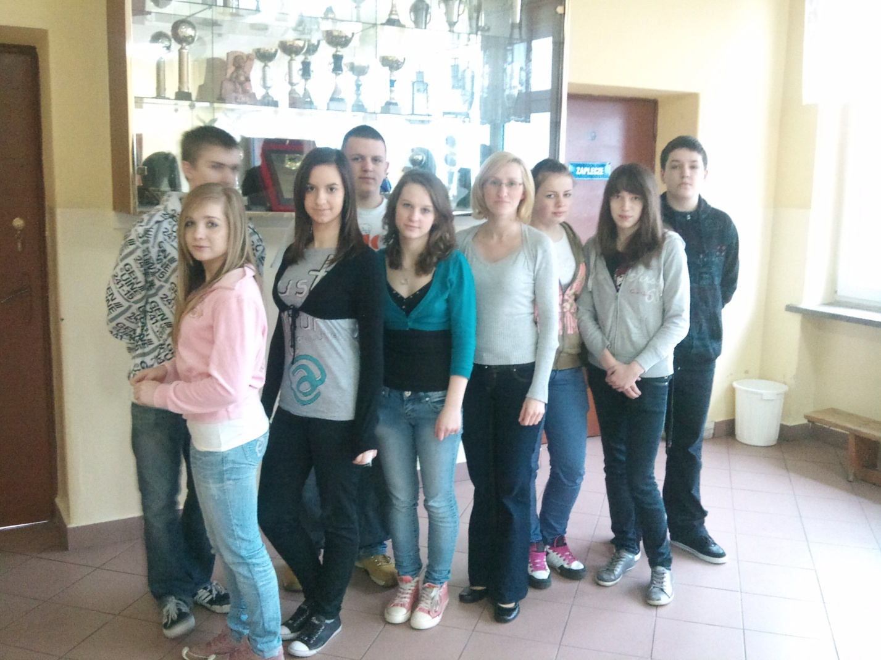
It's us!

