Slide 1
The Righteous AMONG the NATIONS

Slide 2
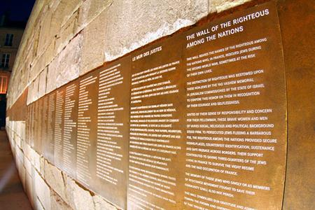
RIGHTEOUS AMONG THE NATIONS
Term applied to non-Jews who saved Jews from their Nazi persecutors by endangering their own lives.
Up to January 1, 2005, some 20,750 persons had been awarded the Righteous title, including men and women from all European countries, as well as persons from other countries who acted to save Jews in Europe during the Holocaust.
A person honored with the title of "Righteous Among the Nations," whether living or dead, is entitled to a medal and certificate of honor, as well as inscription of the person's name on honor walls in the Garden of the Righteous Among the Nations.

Slide 3
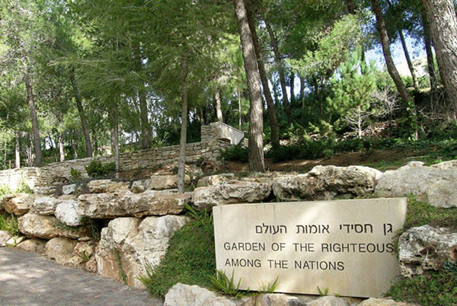
The planting of trees in honor of the Righteous was discontinued in 1989, due to the lack of space, after close to 2,000 trees had been planted representing some 3,000 persons.
The medal was designed by the Jerusalem artist Nathan Karp; depicted on it are two hands holding onto a rescue line woven out of barbed wire. The rescue line is wound around the globe and there is a feeling of movement in its rotation. The globe is surrounded by the rabbinic saying,
"Whosoever saves a single life, it is as if he has saved an entire world."

Slide 4
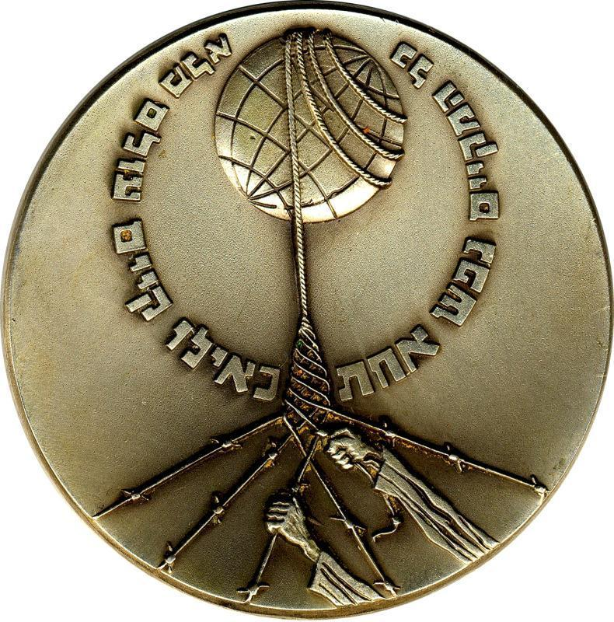
Two hands clutching a rescue line spun from barbed wire strands. The barbed wire lines emerge from empty space but the rescue line enfolds the globe and serves as a handle by which to rotate it (a symbolic expression of the idea that it is deeds such as performed by the rescuers that make the world go around). The globe is surrounded by an inscription "He who saves one soul is like he who saved a whole world"

Slide 5
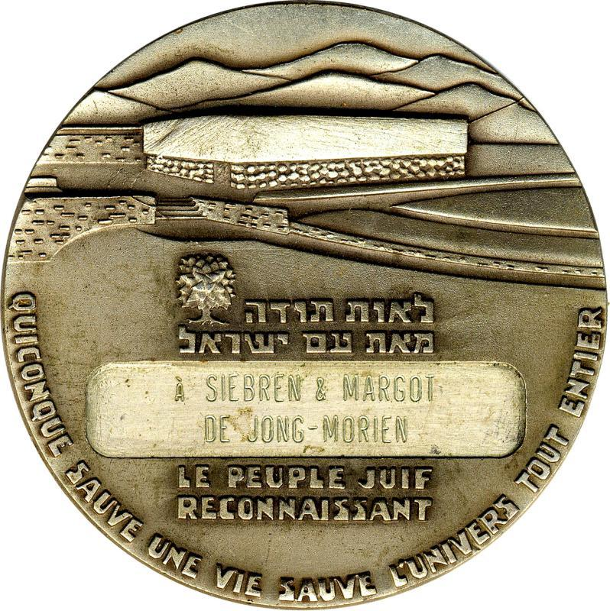
Reverse Above, a schematic version of "yad Vashem", and the memorial hill in Jerusalem. In the center, the Hebrew inscription "A token of gratitude from the Jewish people". Below, the French translation. Also the French translation of "He who saves one soul is like he who saved a whole world".

Slide 6
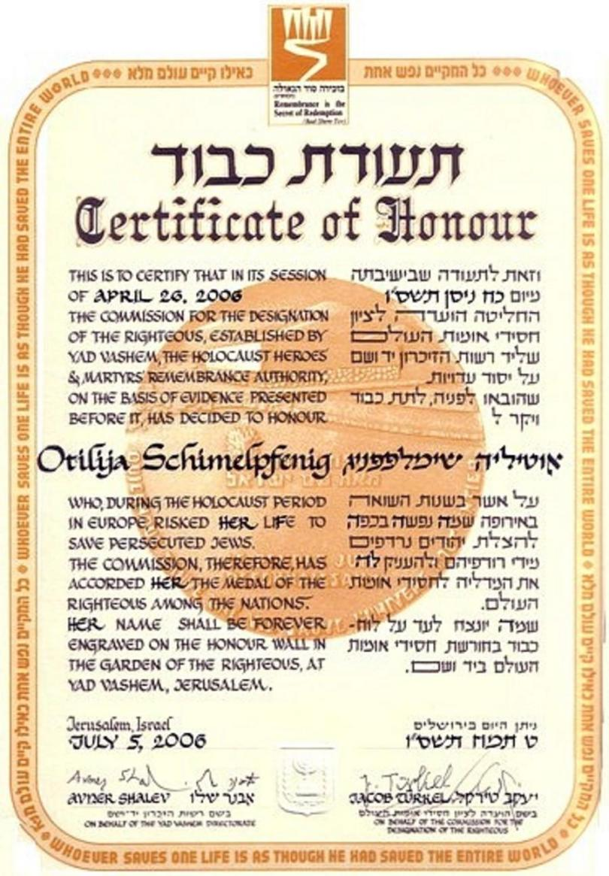
Sample of award documents:

Slide 7
Forms of Aid
- sheltering
- dissimulating
- moving
- help to children
Risks to the Rescuer
- the death penalty

Slide 8
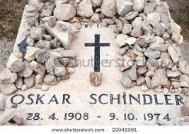
Stones on Oscar Schindler’s grave

Slide 9
Putting Stones on Jewish Graves
the stones symbolize the permanence of memory
Why should they leave stones rather than flowers?
the sense of solidity that stones give
the permanence of memory. Stones do not die
while other things fade, stones and souls endure

Slide 10
From where does this strange custom come?
IT COMES FROM REFERENCES TO THE BIBLE
In the words of the popular Israeli song
"There are men with hearts of stone, and stones with the hearts of men."

