Slide 1
FOOD
Around My Country
IRAQ!

Slide 2
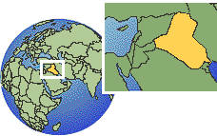

Slide 3
FOOD is so important for us and that’s why eating is a social activity. We eat in the morning, we eat in the afternoon and we eat in the night. We eat different dishes form meal to another and from occasion to another. Sometimes we eat our own Iraqi dishes and sometimes we eat Jordanian, American, European and any middle east dish.
We eat fast food especially in week-ends. People who are busy in working and studying they also usually eat fast food.
For me, I eat everything delicious and I don’t care if it’s Iraqi, Jordanian or even Italian. And this is my banner :
Food is your body's fuel. Without fuel, your body wants to shut down!
Ken Hill

Slide 4
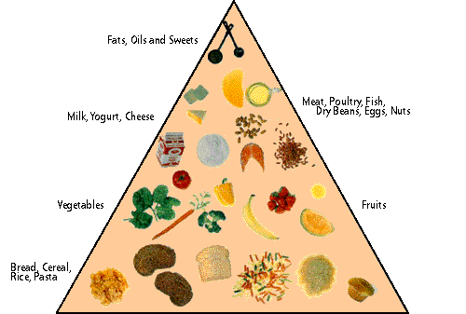

Slide 5
I will start with Breakfast: We usually eat a dish called “KAHI” it’s the most famous paste in Iraq and it’s the most eaten dish on breakfast especially on Fridays!
Here’s its recipe:
1)1 kilo of flour
2) Small amount of Salt
3) Warm water
4) Left the paste outside for a quarter hour
5) Put oil on the dough and extend it
6) Put a moderate amount of butter while you are extending
7) Put the dough in a tray then put it in the oven for 10 minutes on 250 F*
Then get it out of the oven and put a large amount of honey on it and you could eat it with cream, it would be more delicious!

Slide 6
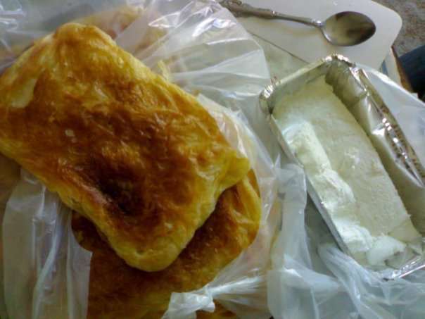

Slide 7
Here’s another famous breakfast dish:
“Bean Porridge “(Bean with Bread) - the Recipe :
Soaked bean
Salt
Onion
Oil (2 tablespoon)
Lemon
Dry spearmint
Bread
Put the bean into warm water for 5 hours or more. Then start Reddening the bean with the onion, oil and salt for I,5 min. put the bread into a large dish and then pour the bean boiling water over it, and finally put the lemon and the dry spearmint on the bread and bean for tooling! Sometimes we add stirred egg over it.

Slide 8
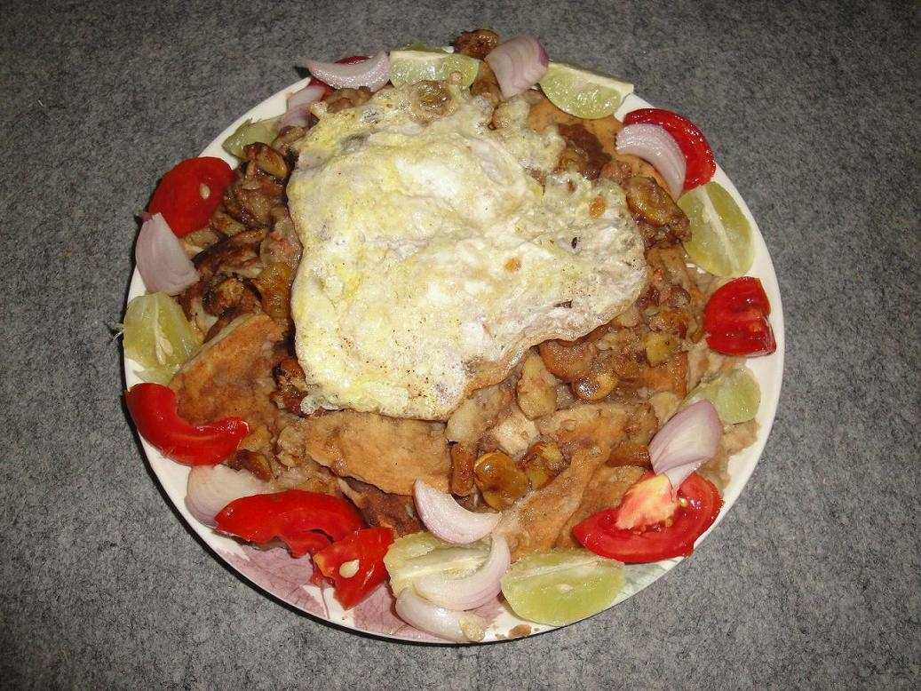

Slide 9
For launch , we eat different dishes but for me this is the best: “Doulma “, it contains grape leaves, tomato, onion, eggplants , zucchini and bell pepper . We annotate them with special filling
Minced meat (optional)
Minced onion
Minced tomato
Spices – any kind you want-
Rice
Lemon juice
Minced parsley
Put the fillings into the vegetables I mentioned after digging them except the grape leaves of course, you should put the filling inside it and then wrap it carefully. Put them all in a pot on oil with small amount of water then leave the pot on the oven until you smell the scent!!! ☺

Slide 10
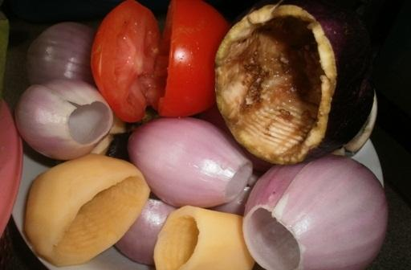
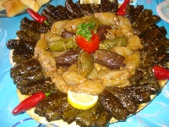
After Digging

Slide 11
This one is special for everyone who loves meat and trust me this dish no one can make it well and tasty like Iraqi and the Levant!
For me I don’t eat it a lot, but only during trips and outgoings. I think you know it because it’s so famous even in Turkey..
It’s “KEBAB “ or “Shish Kebab”…. But we call it“Iraqi Kebab” it makes no different with the others but maybe a little..
You need:
250 gm minced meat 9) Salt
Parsley 10) Black Pepper
2 onions
1 carrot
1 tomato
4 tablespoon of flour
Curry
Turmeric

Slide 12
Chop vegetables except the tomatoes because they don’t bear the chop of more than 2-3 seconds.
Add the vegetables after chopping tomatoes.
Add the pepper and flour.
Mix them until it becomes a paste .
Make each small piece of the paste as a Cylindrical shape .
Heat oil and fry them.
*Illustrations next page*

Slide 13
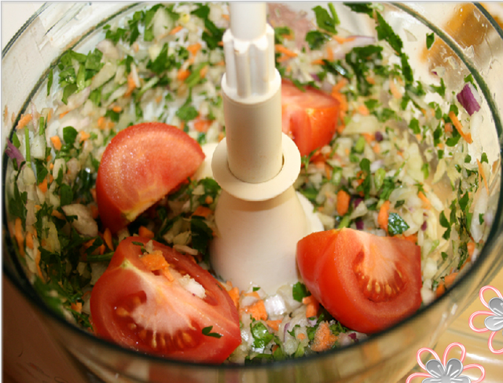
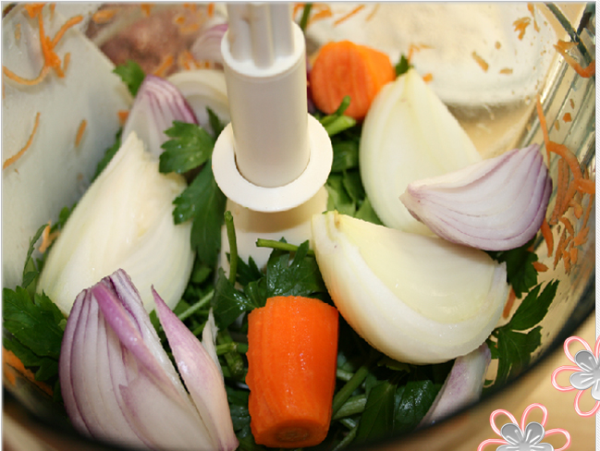
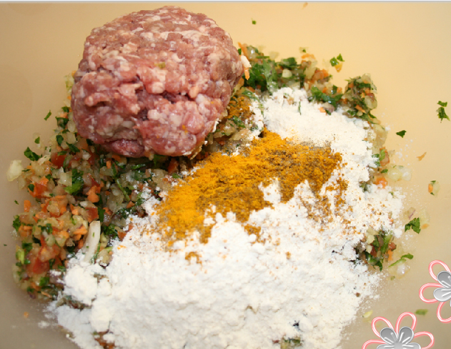
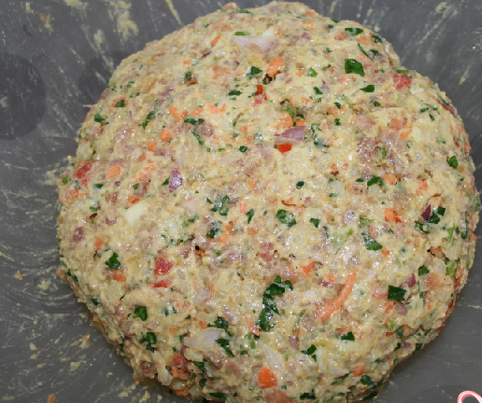
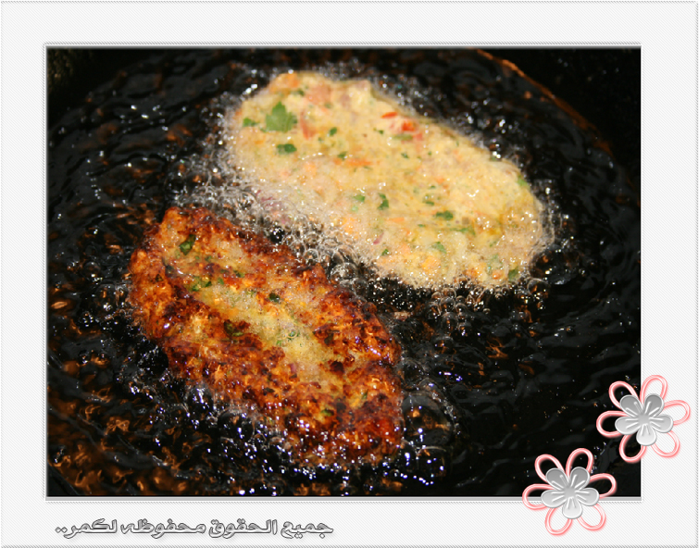
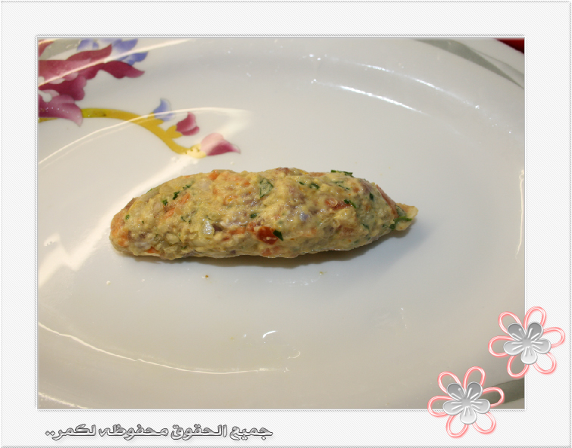
1
2
3
4
6
5

Slide 14
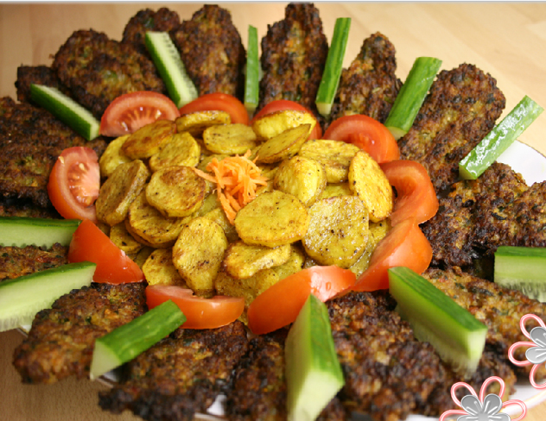

Slide 15
When it comes to desserts , I can only say that “Life is uncertain. Eat dessert first.” Ernestine Ulmer .
We eat many kinds of desserts, even if it wasn’t Iraqi ones. We eat chocolate cakes, caramel cream cake , lazy cake and brownies.
But we have very special desserts , This one you can’t make at home because it needs a special paste that you can’t get so easily! It’s “Znood Alsit” . I simply adore it, we usually eat it in the holy month “Ramadan” . The delicous taste is in the magical cream that I can’t describe……☺

Slide 16
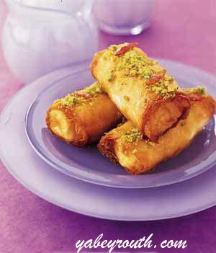

Slide 17
Here’s a dessert that you can make at home and it’s very easy!
“Milk Dessert” …….. But first you need :
1 cup of flour
1 cup of dry milk
1 cup of oil
1-2 tablespoon of starch
Sugar sauce ( 2 cups of sugar, 1 cup of water , 1 tablespoon of lemon juice.
For tooling : crushed green peanut , nuts.
First make the sugar sauce then put the flour, oil , the dry milk and the starch in a large pot and put it on low heat and continue stirring until it becomes brown . Add the sugar sauce to it intermittently while continuing to stir. Keep it for several minutes on the oven to be quiet hold together, finally put it into a flat plate then put the tooling (optional).

Slide 18
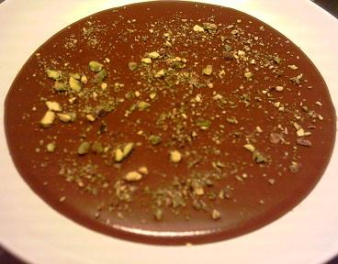

Slide 19


Slide 20


Made By : Fedda M.Jaber – SILVER-

Slide 21


