Slide 1
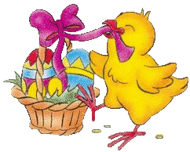
GORGEOUS EASTER……

Slide 2
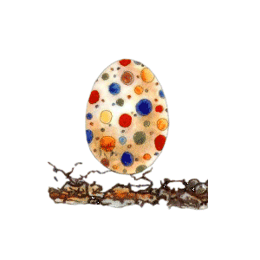
Easter Food History
Eggs are often associated with Easter and are considered a symbol of birth and life. The tradition of giving eggs as gifts can be traced back to the Persians who used to exchange eggs at the beginning of Spring, while the custom of decorating eggs was popular in ancient Egypt. The tradition of exchanging eggs for Easter, however, dates back to the Middle Ages, beginning in 837 AC when it was prohibited to eat animal products during Lent. During the forty days prior to Easter, eggs were conserved and decorated. Beginning in the 12th century, the eggs were blessed and given to servants and children as part of a ritual called “Benedictio ovorum.” This is where the tradition of exchanging Easter eggs all began, well before the arrival of chocolate in Europe. Originally, eggs were painted in various colors and given to children in the streets of Europe as an Easter present. The tradition of chocolate Easter eggs probably began as late as the 19th century.

Slide 3
Traditional Easter meals vary from region to region, but eggs and roasted lamb are common elements everywhere. Eggs represent life, fertility, and renewal, all of which are essential symbols of Easter. Dyed eggs grace many Easter tables, and eggs are often found in soups
Roasted lamb, as a symbol of birth and the Shepard, is a traditional main course.
Chocolate bunnies are not common, but beautifully decorated chocolate eggs are a traditional Easter treat and gift! Chocolate eggs are a symbol of Easter even for non religious people. Everybody gets an egg for their dear ones.
The official Easter cake is the Eastern Dove (Colomba) that represents peace

Slide 4
1. Easter breakfast Families from Italy’s central regions prepare a nest for the Easter breakfast, containing holy Easter bread, salami, wine and colored boiled-eggs. They usually go to the church on the Saturday before Easter to let the nest be blessed with a catholic ritual.
2. Easter breads and pies These are not the standard breads one buys day-to-day in Italian bakeries, but rather something more: Breads that contain cheese, sausage, salami, a lot of butter and even hard-boiled eggs.
3. Fresh peas Fresh peas are one of the most eagerly awaited signs of Spring in Italy, and no Easter table is complete without them. The most classic Italian way of preparing peas is with pancetta or prosciutto and parsley.
4. Roast lamb The lamb is a central feature in the Christian religions. In Italy the leg of lamb is a typical Easter lunch dish.
6. Colomba This dove shaped breads are often given as gifts. It´s made with almonds, sugar and egg whites.
7. Chocolate eggs Italian kids won't wait for the Easter bunny. Instead of that we have lots of other sweeties, for instance chocolate eggs, which usually come with a surprise inside

Slide 5
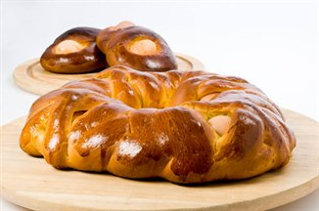
PICCILLATU A TYPICAL EASTER BREAD FROM CALABRIA
This old, yet original Easter recipe calls for eggs wrapped in dough
Time: 3 hours and 40 minutes
1lball-purpose flour
½ oz fresh yeast
3ozsugar
3ozlard
¼ cup water
¼ cup anise liqueur
half lemon zest, grated
2eggs
salt to taste
Garnish
1whisked egg
egg, per ring
INGREDIENTS Servings 6 For the dough

Slide 6
3 hours preparation + 40 minutes cooking
Begin by preparing the starter (biga in Italian), which will improve the leavening of the dough. To make the starter, mix together 1/3 of the flour, the yeast and water in a bowl. Mix until smooth and uniform. Then shape the starter into a ring and, to make it rise quickly, place it in the bottom of a bowl of hot water so that it is completely covered. In the meantime, use the remaining dough to make a well on a flat work surface. To the middle, add the sugar, salt, lard and grated lemon peel. As soon as the starter floats to the top of the bowl, it has finished rising. It can now be removed from the water and placed in the center of the well with the other ingredients. Also add the eggs and anise liquor. Mix everything together for a long time, preferably using a mixer, until the dough is smooth and elastic. Shape the dough into a ball and dust with flour. Let rise in a glass bowl, covered with a sheet of plastic wrap, in a warm place for about half an hour. Once the dough is done rising, divide the dough into as many cakes as you would like to make. Roll each piece into a long, thick log. Shape each log into the form you prefer (a ring, an eight or a braid). Place the raw eggs (in their shells) in the middle of any holes in the dough. Place the rings on a baking sheet lined with parchment paper. Cover with sheet of plastic wrap or and let rise for 30 to 45 minutes in a warm place. Once the dough is done rising, brush it with whisked egg and bake in a 400° F oven for 40 minutes or until golden.

Slide 7
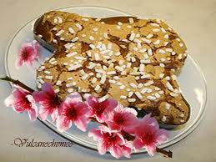
Colomba – Easter Dove Cake In Italy, this delicious cake is typically eaten at Easter Time: 55 minutes.
The dove is a Christian symbol representing the Holy Spirit, announcing the reconciliation between God and man or, more simply, heralding the arrival of spring.
1lball-purpose flour
5ozbutter
4 ½ozsugar
1 ¾ozfresh yeast
3eggs
5ozmixed candied fruit
almonds, sweet to taste
coarse sugar to taste
⅛oz salt

Slide 8
Preparation 30 minutes preparation + 25 minutes cooking
Dissolve the yeast in a little warm water and slowly work in half of the flour; allow the dough to rise in a warm place in a floured bowl. When the dough has doubled in size, place it in a larger bowl and add the remaining flour, beaten eggs, melted butter, sugar and salt. Work the dough gently until it stops sticking to the sides of the bowl, cover with a cloth and allow to rise for another hour. Sprinkle flour on the raisins and the candied peel then shake excess flour away in a sieve. Add the raisins and candied peel to the dough, place in a dove-shaped mould and decorate with almonds, baste with beaten egg and sprinkle with sugar crystals. Cook in a moderate oven for 20-25 minutes.

Slide 9
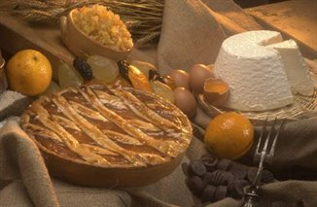
Pastiera (traditional Neapolitan cake)
This rich Easter cake from Naples has a flavor all of its own. Time: 2 hours
INGREDIENTS For pasta
5 oz butter
4 oz confectioners sugar
3 egg yolks
½l ball-purpose flour
For filling
1lbricotta cheese
½lb granulated sugar
½lb cooked wheat
3 oz milk
3 eggs
lemon zest, grated
1 ozorange flower water
vanilla to taste
cinnamon to taste
3 oz mixed candied fruit
1 oz butter
1 oz confectioners sugar
salt

Slide 10
Neapolitan pastiera is an Easter cake and, according to tradition, every family in Naples prepares one during Holy Week to be eaten on Easter day. The recipe for this cake probably derives from the breads made from milk and honey that were commonly eaten during the baptism ceremonies the night of Easter when Constatine was Emperor. The modern version of this cake was invented at the convent of San Gregorio Armeno, which at the time was located in Naples. A nun decided to make a cake using the ingredients that symbolized life and the resurrection. However, there is another ancient legend surrounding the creation of the pastiera. Some believe that the siren Partenope would come out from the water of the Gulf of Naples every spring, delighting people with her lovely songs. Apparently on year, the people of Naples fell so in love with her songs that they decided to offer her the most precious products of their land. Seven of the most beautiful girls of the area gave the beautiful siren flour, ricotta, eggs, wheat, orange flower water and spices, including cinnamon and sugar. Partenope, thrilled with her gifts, decided to return to her home under the sea and to offer her gifts to the Gods. To honor her beauty, the Gods mixed the ingredients together, creating a cake as delicious as the voice of the siren: la pastiera napoletana.

Slide 11
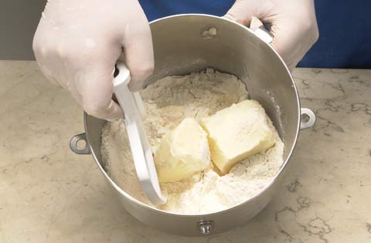
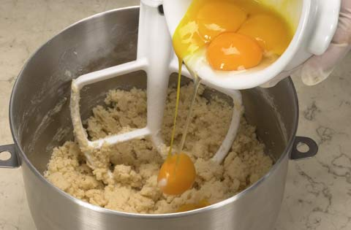
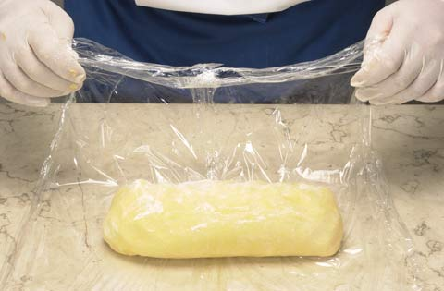
Step 1 Put the flour and butter into a food mixer, mix until grainy.
Step 2
Then blend in the yolks, the powdered sugar, the vanilla and mix further (being careful not to over-mix).
.
Step 3
When the dough is ready, wrap it in cling-film and leave in the fridge for 2 hours.

Slide 12
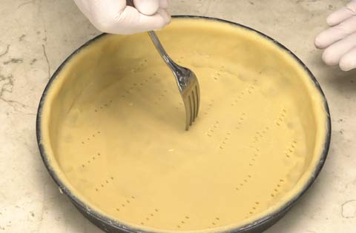
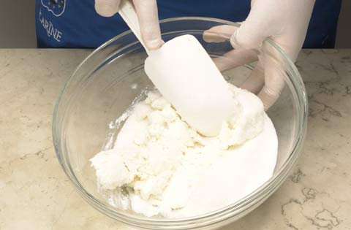
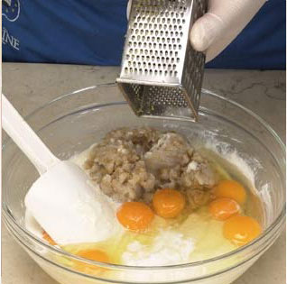
Step 4
Roll the dough to a thickness of 0.2 inch, use it to line a cake pan and prick the pastry all over with a fork
Step 5
Put the ricotta into a bowl with the sugar and mix together.
Step 6
Finish by adding all the ingredients for the filling, mixing together well, and taking care not to let it collapse

Slide 13
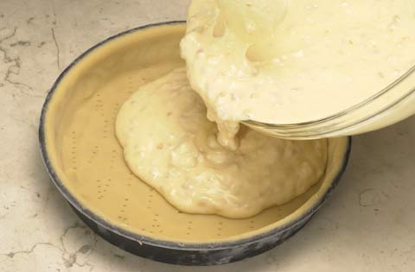
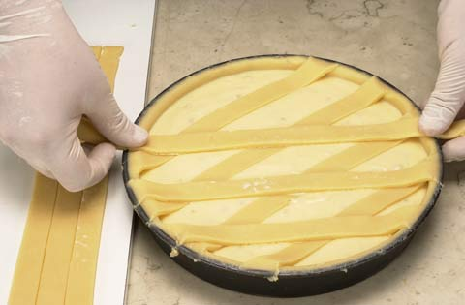
Step 7
When the filling is finished lay it in the lined cake pan.
Step 8
Make strips of pastry and lay them crisscross across the top of the cake like a fruit flan. Bake at 360°F for about 1hour and 30 minutes
TIPS THE FILLING MUST BE PARTICULARLY SOFT, BUT NOT TOO MOIST. IT IS PREFERABLE TO USE A RICOTTA CONTAINING PART EWE’S MILK. THE WHEAT MUST BE WELL-COOKED. BEFORE REMOVING FROM THE TRAY, WAIT UNTIL IT HAS COOLED ENOUGH. THIS IS A DESSERT SERVED AT ROOM TEMPERATURE WHICH REQUIRES A LONG PREPARATION TIME. WHAT IS CHARACTERISTIC ABOUT THE CAKE IS THE USE OF THE WHEAT AND THE RICOTTA CHEESE. MOREOVER, ITS CHARACTERISTIC AROMA IS BASED AROUND THE MILLEFIORI ESSENCE.

Slide 14
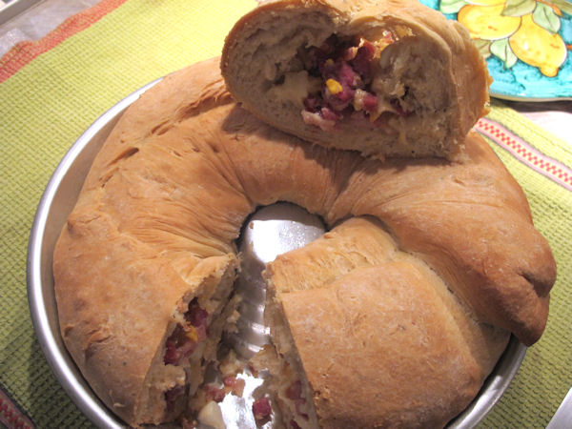
NAPOLITAN CASATIELLO
A type of rustico, or a rustic bread, Casatiello is hardy, filling, and oh so satisfying.
Two breads cut from the same dough, the only difference between them – hard-boiled eggs. Perhaps symbolic of creation, I can only guess the addition of eggs to Casatiello render it suitable only for the Easter holiday. Made in a round pan similar to an American Bundt pan, the shape is said to symbolize the crown of thorns.
The recipe dates to at least the 1600s and they say, the Napoletani that is, that it is not Casatiello without sugna (or strutto in Italian) - pork fat/lard. Served as part of the antipasti on Easter day, it tastes even better the next day, Pasquetta – Easter Monday.

Slide 15
Ingredients
For the dough 1 kg flour plus extra for rolling the dough 1 cake (.6 oz) fresh yeast or one package or 2 1/4 tsp active dry yeast Warm water Salt and pepper About 4 tbsp of lard for the dough plus more for coating the dough
For the filling 1/2 kg assorted salumi and cheese 6 hard-boiled eggs
Cooking Method
Pour flour onto a work surface Mix in salt and a very generous amount of pepper Add yeast (if you are using active dry yeast you will need to dissolve it in about 1/2 cup warm water first) Add water a little bit at a time, working it in until a soft dough begins to form Add the lard and work it completely into the dough Continue working the dough, adding water as needed until the dough is just slightly damp and very elastic Cover with a kitchen towel and let rise 1 hr

Slide 16
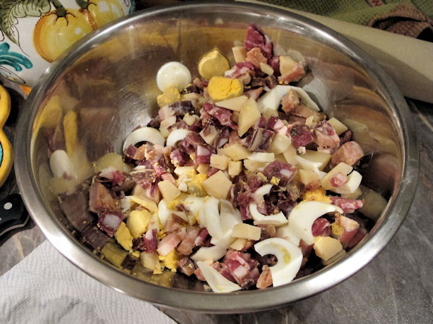
The Casatiello dough after the first rise
Meanwhile chop the salumi and cheese Boil and chop the eggs and add them to the salumi mixture
After the dough has risen one hour, flour the work surface and roll it out into a large rectangular form.

Slide 17
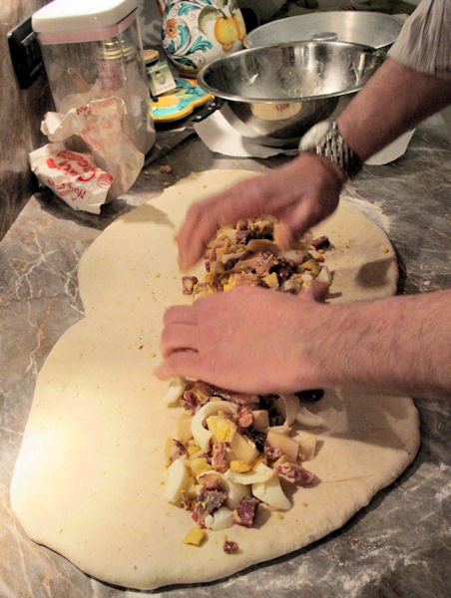
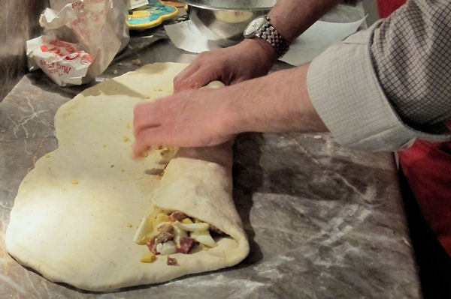
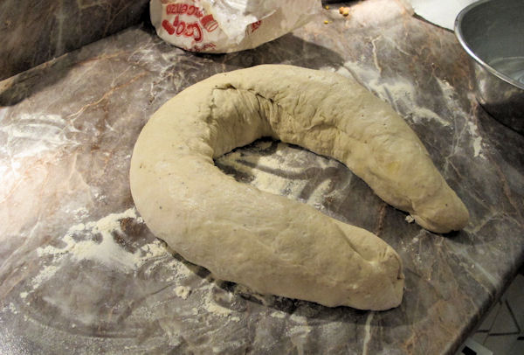
Spread the salumi mixture across the length of the dough starting near the bottom of the dough
Spread the filling out towards the bottom of the dough
Roll the dough up like a cigar, pinch the edges and coat them with lard.
Roll up the Casatiello
Bring the ends together
to form a circular shape

Slide 18
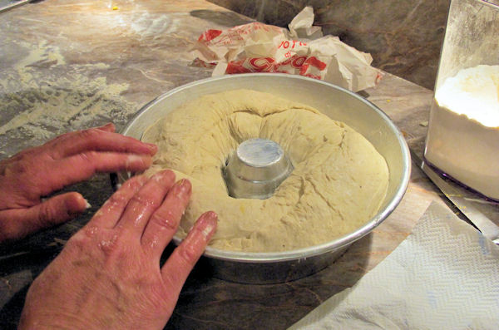
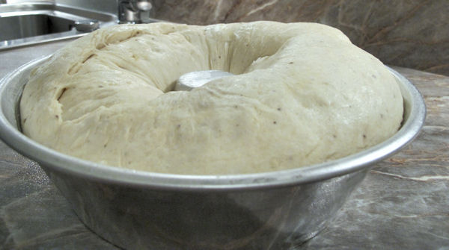
Grease the Casatiello pan with lard, work the dough into the pan and generously coat the top of the dough with lard.
Cover and let rise an hour.
Casatiello after the second rise
Bake at 160º C for approximately 1 1/2 to 2 hours.

Slide 19
