Slide 1
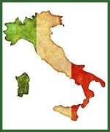
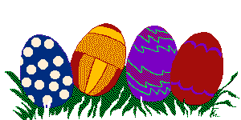
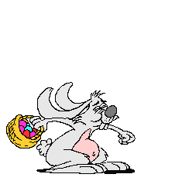
EASTER IN ITALY
Solemn religious processions are held in many towns …... Many churches have special statues of the Virgin and Jesus that play a big part in the processions. The statues may be paraded through the city or displayed in the main square. Parade participants are often dressed in traditional ancient costumes. Olive branches are often used instead of or along with palm fronds in the processions and to decorate churches.

Slide 2
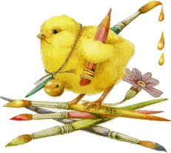
The Easter celebration The Nicean Council decided in A.D. 325 that Easter would be celebrated on the first Sunday after the first full moon after the Spring Equinox. Unless the first full moon also rose on a Sunday, in which Easter would be celebrated the Sunday after that. For over 1500 years we have continued to mark the celebration of Easter based on these calculations.

Slide 3
Easter’s celebrations
LENT
PALMS SUNDAY
HOLY FRIDAY
EASTER SUNDAY
SHROVE TUESDAY
EASTER MONDAY ( PASQUETTA)

Slide 4
The Holy Week celebrations
In Italy the fasting of Lent is preceded by a carnival with colorful pageants, masquerades, dancing, music and all kinds of merrymaking.
The Carnival begins in January and lasts until Ash Wednesday.
The activities and merriment of Carnival precede the somber overtones of the Lenten season.

Slide 5
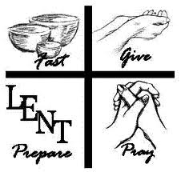
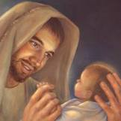
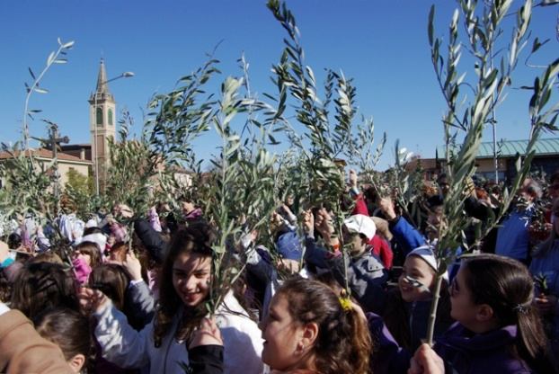
Lent (Quaresima) marks the forty days of fast and abstinence before Easter; marked with the Feast of St. Joseph (Festa di San Giuseppe) on March 19th and Palm Sunday (Domenica delle Palme), in which palms and olive branches are blessed by the parish priest and given out to the congregants.

Slide 6
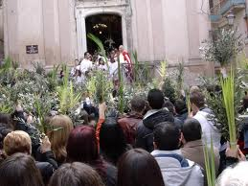
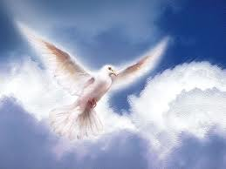
On Palm Sunday, the churches are bedecked with baskets of palms and olive branches
Many churches still follow the tradition of having the priest knock three times from the outside of the closed church doors to symbolize Jesus‘s entry into Jerusalem. The local parish priests go round knocking on the neighborhood's door for the Easter Blessing.

Slide 7
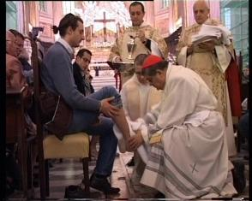
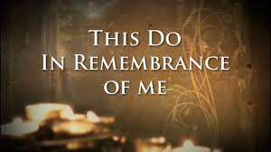
On Giovedi Santo or Holy Thursday many churches re-enact the ceremony of the washing of the feet at the altar. It is often marked in the churches with a ritual washing of the feet, with the priest symbolizing the role of Jesus, and twelve church members symbolizing the role of the apostles.

Slide 8
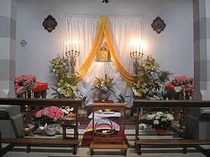
The altar of repose hosts the Communion, consecrated in the Mass of the Lord’s Supper and reserved for the following day, Good Friday, the day on which the death of Christ is observed liturgically and Mass is not celebrated, so communion must be given from Hosts consecrated on the previous day
Mention of the altar of repose and the procession to it is not found before the close of the fifteenth century. The reservation of the Consecrated Species in the Mass of Holy Thursday, spoken of in earlier liturgical works, was for the distribution of Holy Communion, not for the service on the following day.

Slide 9
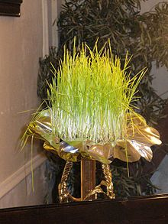
It is decorated with so-called "lavureddi“: bowls where on the first day of Lent are stretched cloth or cotton wool, on which spreads wheat and legumes. Made by the congregants, 3 for each family; thus symbolising the Trinity….
Then they are stored in the dark and watered from time to time so that on Holy Thursday, once sprouted, it will face in the form of pale and thick filaments of different colors.

Slide 10
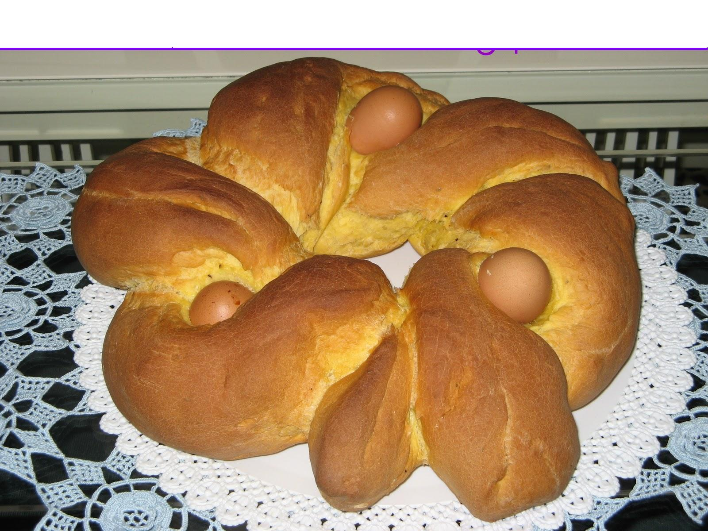
Pancakes are a traditional Shrove Tuesday feast food. Older church doctrine decreed that Catholics give up more than meat dishes for Lent - eggs, milk, and even fats were also restricted for the observant. Because Shrove Tuesday is the last day until Easter that people could spoil themselves, pancakes soon became a traditional Shrove Tuesday feast.

Slide 11
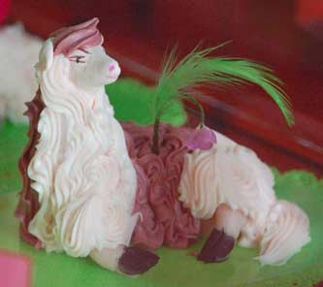
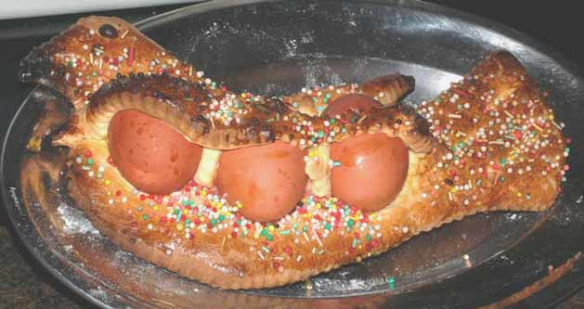
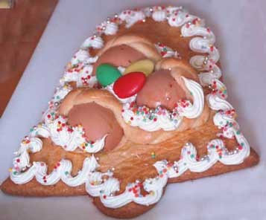
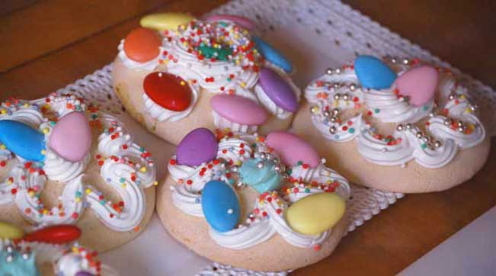
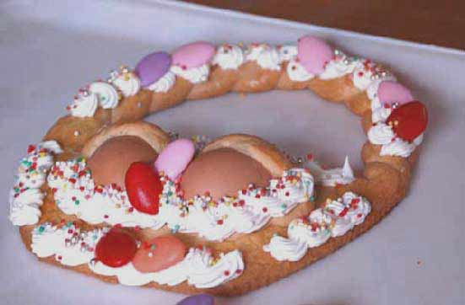
EASTER BISCUITS SYMBOLISING FAITH….

Slide 12
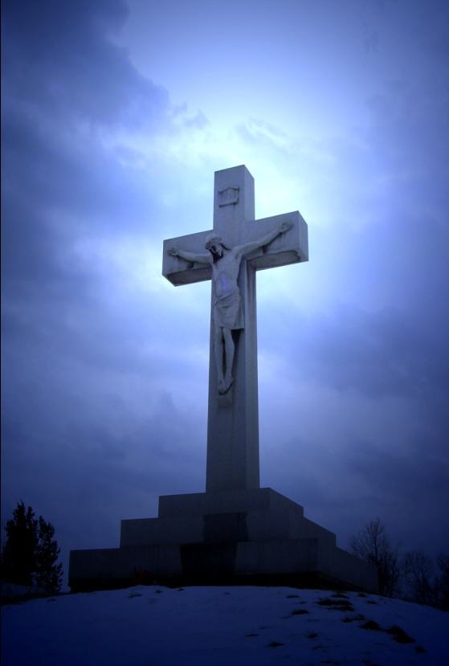
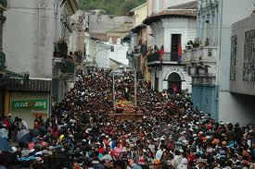
Good Friday and Easter Week Processions
Solemn religious processions are held in many towns on the Friday or Saturday before Easter and sometimes on Easter Sunday. Many churches have special statues of the Virgin and Jesus that play a big part in the processions. The statues may be paraded through the city or displayed in the main square.

Slide 13
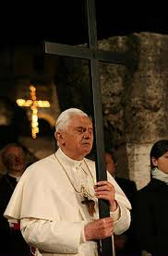
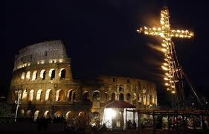
On Good Friday there is a Papal Mass at the Vatican in Saint Peter's Basilica at 5PM. In the evening the ritual of the Stations of the Cross, or Via Crucis, is enacted near Rome's Colesseum, usually starting at 9:15PM. The stations of the Via Crucis were placed at the Colosseum in 1744 by Pope Benedict XIV. A huge cross with burning torches lights the sky as the stations of the cross are described in several languages. At the end, the Pope gives a blessing.

Slide 14
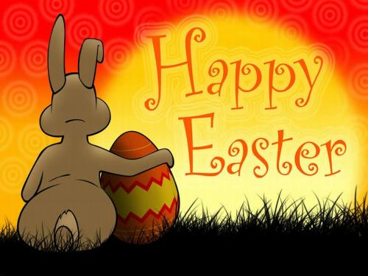
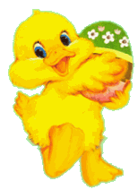
EASTER SUNDAY people go to the church for the celebration of Easter mass service and eat chocolate eggs ..

Slide 15
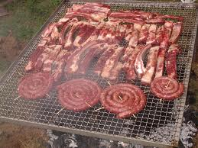
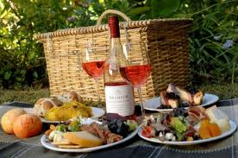
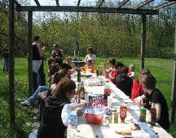
Easter Monday, also known as Little Easter (Pasquetta) is also an official Italian holiday that is often spent enjoying the fresh Spring weather with family and friends in picnics.
Traditionally Easter Monday is the time to
move out of the cities and into the fresh air
of the countryside.

Slide 16
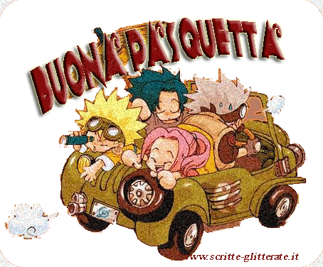

Slide 17
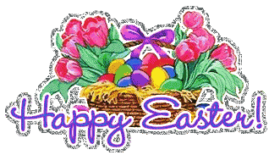
Although there is the old Italian saying ……. "Christmas at home and Easter with whomever you wish“ Easter is an occasion for families to reunite around a well-set table. Remember that GLOBALISATION has turned a religious celebration into a gourmande occasion to spend with friends and for young people to enjoy a school vacation……

Slide 18
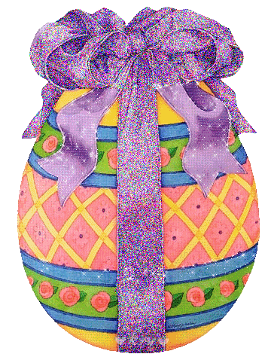
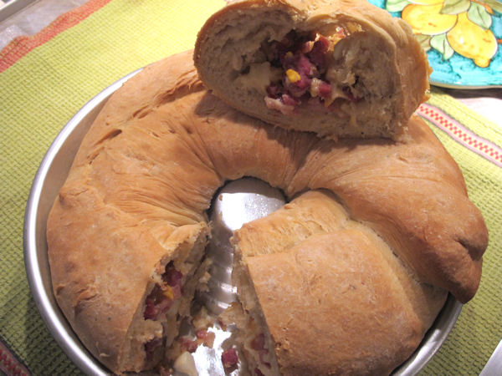
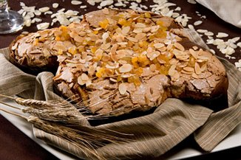
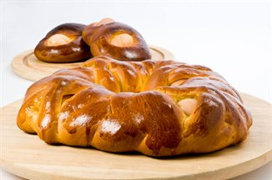
SPECIAL FOOD AT EASTER
PASTIERA
UOVA DI PASQUA
CASATIELLO
PICCILLATO
COLOMBA

Slide 19
EASTER FOOD
The Easter dinner is usually a sumptuous feast arranged with special delicacies.
The most important dish is Agnellino, roasted baby lamb.
Eggs feature prominently in the day's dishes
Colomba (dove shaped) breads is also given as gifts.
Hollow chocolate eggs that usually contain something surprising inside are also presented to near and dear ones

Slide 20
